Slide 1
p125(Insurance Analytics)
Presented by: (From group 5) Swapnil, Shruti, Gayatri, Theja, Chandan, Dinesh and magesh

Slide 2
Table of content
INTRODUCTION
BRANCH DASHBOARD INTRODUCTION
EXCEL DASHBOARD
TABLEAU DASHBOARD
POWER BI DASHBOARD
KPI List and Metrics
Project Members and Files
CONCLUSION
THANK YOU

Slide 3
Introduction
Insurance analytics is a project aimed at analyzing the performance of various branches and account executives of an insurance company. The goal of the project is to identify areas of improvement and help the company make data-driven decisions to increase revenue and customer satisfaction.
The problem statement for this project is to identify which branches and account executives are performing well and which ones need improvement. By analyzing various kpis such as number of invoices, yearly meeting count, and stage funnel by revenue, we can provide valuable insights to the company.
The objective of this analysis is to improve the performance of the insurance company by identifying the areas that require more focus and attention. By leveraging data, we can help the company optimize its operations, increase revenue, and improve customer satisfaction.

Slide 4
Branch Dashboard
Our Branch Dashboard provides a comprehensive overview of the performance of each branch, including new and renewal business numbers, individual performance within the branch, and percentage of achievement for placed and invoice.
Key Features:
New and renewal business numbers by branch
Individual performance within each branch, including new, cross-sell, and renewal targets and achievements
Percentage of achievement for placed and invoiced business
Number of meetings for the current year
Open opportunity report and closed won opportunities
Conversion ratio (Closed Won/Total Opportunity)

Slide 5
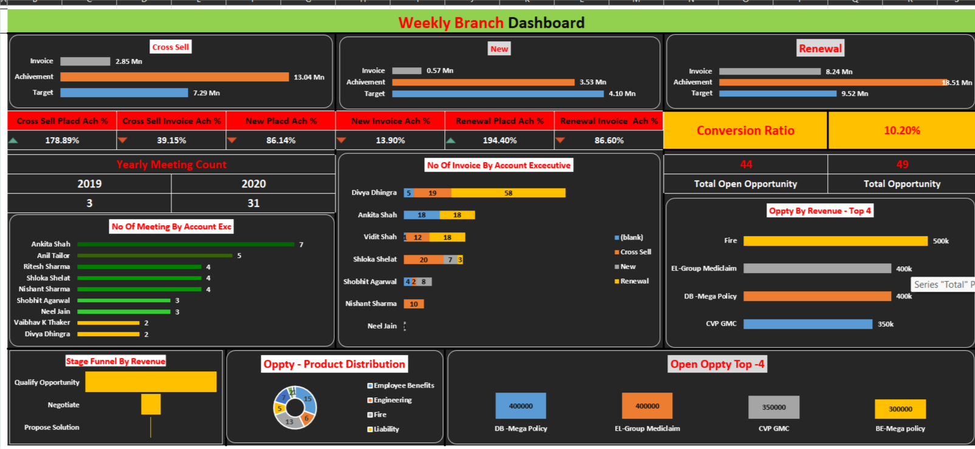
EXCEL DASHBOARD

Slide 6
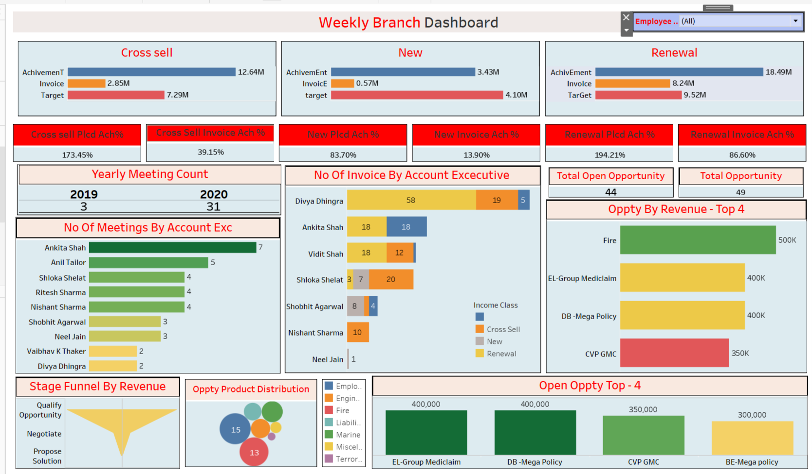
TABLEAU DASHBOARD

Slide 7
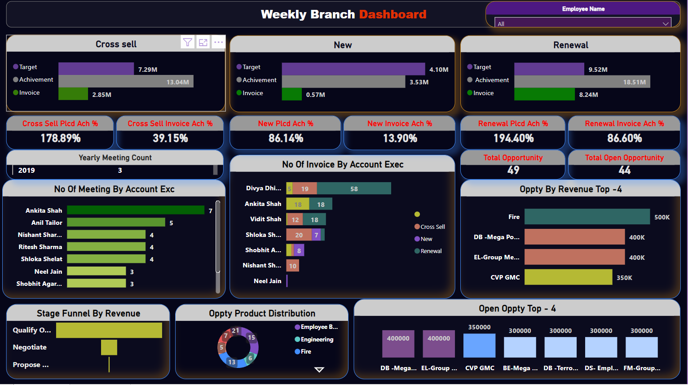
POWER BI DASHBOARD

Slide 8
KPI List and Metrics
Number of invoices by account executive
Yearly meeting count
Cross-sell, new, and renewal targets
Stage funnel by revenue
Number of meetings by account executive
Top open opportunity

Slide 9
Project Members and Files
Project Members | Contact Information
Swapnil Vijay Kamble | swapnil.kamble1987@gmail.com, 8169433098
Chandan Gope | chandangope032@gmail.com, 7903182523
Mrs. Gayatri Sharad Gadhave | gayatridange2@gmail.com, 9503612516
Mrs. Shruti Min | shrutimmin3@gmail.com, 8320454378
Mr. Dinesh Damodhar Hande | handedinesh84@gmail.com, 9665542683
Miss Theja R M | tejarm12@gmail.com, 9108004083
Magesh k | mageshkesavan72@gmail.com, 7418786343
Project Files:
Excel file:
Power BI file:
Tableau file:
Other relevant files:

Slide 10
CONCLUSION
In conclusion, the insurance analytics project provided valuable insights into the performance of the company’s
Various branches and account executives. Through the use of excel, power BI, and tableau, we were able to
Develop a comprehensive branch dashboard that allowed us to identify key areas for improvement.
Key findings:
Some account executives had higher conversion ratios than others, indicating room for improvement in lower-performing executives
The number of meetings held by some executives was below average, highlighting a need for increased focus on this area
The majority of open opportunities were in the "propose solution & qualify opportunity" stage, indicating a need for more targeted and effective sales strategies
Recommendations:
Provide additional training and resources to improve the conversion ratios of underperforming executives
Increase the number of meetings held by executives with lower meeting counts
Develop more targeted sales strategies to increase the conversion rate of open opportunities

Slide 11
THANK YOU

